Slide 1
Finite Mathematics and Calculus with Applications 10th Edition
Lial / Greenwell / Ritchey

Slide 2
Chapter 15
Integration
Contains:
Definitions, Theorems, Properties
Examples
Figures
Tables

Slide 3
15.1
Antiderivatives

Slide 5

Example: Antiderivative
(Your Turn 1 in Text)
Find an antiderivative $f\left(x\right)=8x^{7}$.
Solution: To find a function $F(x)$ whose derivative is $8x^{7}$, work backwards. Recall that the derivative of $x^{n}$ is ${nx}^{n−1}$.
If${ nx}^{n−1}$ = $8x^{7}$, then $n − 1 =7$and n = 8, so $x^{8}$ is an antiderivative of ${8x}^{7}$.

Slide 6
Slopes of the Tangent lines
(Figure 1 in Text)

Slide 10
Example: Power Rule
(Your Turn 2 in Text)
Solution:

Slide 12
Example: Rules of Integration
(Your Turn 3 in Text)
Solution: By extending the sum and difference rules to more
than two terms, we get

Slide 13
Example: Rules of Integration
(Your Turn 4 in Text)
Solution: First rewrite the integrand as follows.

Slide 16
Example: Exponential Functions
(Your Turn 5 in Text)
Solution:

Slide 17
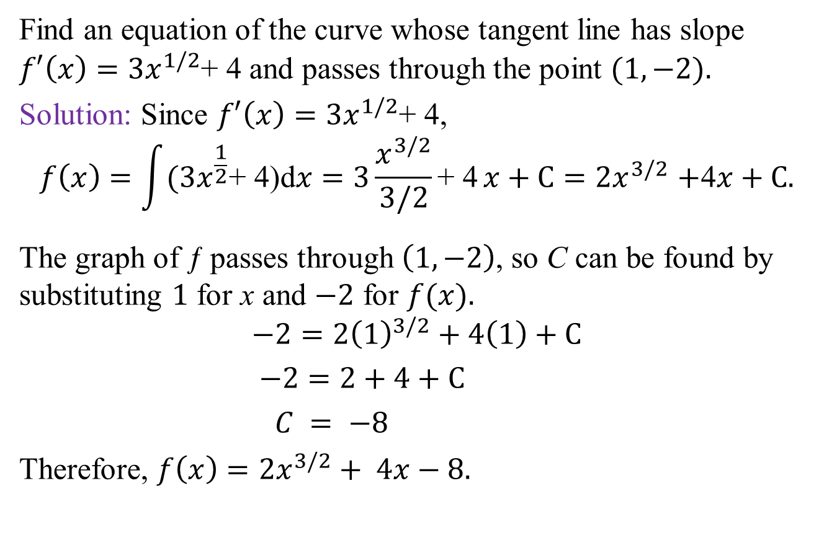
Example: Slope
(Your Turn 7 in Text)
Find an equation of the curve whose tangent line has slope $f′\left(x\right)=3x^{1/2}$+ 4 and passes through the point $(1, −2).$
Solution: Since $f′\left(x\right)=3x^{1/2}$+ 4,
$$f\left(x\right)=\int{(3x^{\frac{1}{2}}\text{+ 4}\text{)}\text{d}x=3\frac{x^{3/2}}{3/2}\text{+ 4}}x+C{=2x}^{3/2}+\text{4}x+C.$$
The graph of ƒ passes through $\left(1, −2\right)$, so C can be found by substituting $1$ for x and $−2$ for $f(x).$
$$−2=2{\left(1\right)}^{3/2}+4\left(1\right)+C$$
$−2=2+4+C$
$C = −8$
Therefore, $f\left(x\right)=2x^{3/2}+ 4x−8.$

Slide 18
15.2
Substitution

Slide 19
Example: Substitution
(Your Turn 1 in Text)
Solution:
Now substitute.
Now replace u with

Slide 20
Example: Substitution
(Your Turn 2 in Text)
Solution:

Slide 21
Example: Substitution
(Your Turn 4 in Text)
Solution:

Slide 24
(Figure 2 in Text)
Substitution (Using a Graphing Calculator)

Slide 25
15.3
Area and the Definite Integral

Slide 26
Area and the Definite Integral
(Figure 3 in Text)

Slide 27
Approximation of Area
(Figure 4 in Text)

Slide 28
Approximation of Area
(Figure 5 in Text)

Slide 29
Approximation of Area
(Figure 6 in Text)

Slide 30
Approximation of Area
(Figure 7 in Text)

Slide 31
Approximation of Area
(Figure 8 in Text)

Slide 32
Approximation of Area
(Figure 9 in Text)

Slide 34
Approximation of the Area Under a Curve
(Figure 10(a) in Text)

Slide 35
Approximation of the Area Under a Curve
(Figure 10(b) in Text)

Slide 36
Finding the Area Under a Curve
(Figure 11 in Text)

Slide 38
(Figure 12(a) in Text)
Definite Integral (Using a Graphing Calculator)

Slide 39
(Figure 12(b) in Text)
Definite Integral (Using a Graphing Calculator)

Slide 41
(Figure 13 in Text)
Approximation of Area

Slide 42
(Figure 14(a) in Text)
Lists (Using a Graphing Calculator)

Slide 43
(Figure 14(b) in Text)
Lists (Using a Graphing Calculator)

Slide 46
(Figure 15 in Text)
Oil Leakage

Slide 48
15.4
The Fundamental Theorem of Calculus

Slide 50
Example: Fundamental Theorem of Calculus
(Your Turn 1 in Text)
Solution: By the power rule given earlier, the indefinite integral is
By the Fundamental Theorem, the value of the definite integral is found by evaluating as follows with no constant C required.

Slide 51
(Figure 16 in Text)
Fundamental Theorem of Calculus

Slide 53
(Figure 17 in Text)
Fundamental Theorem of Calculus

Slide 54
Example: Fundamental Theorem of Calculus
(Your Turn 2 in Text)
Solution: Use the Fundamental Theorem.

Slide 55
(Figure 18 in Text)
Area

Slide 56
(Figure 19 in Text)
Area

Slide 57
(Figure 20 in Text)
Area

Slide 59
15.5
The Area Between Two Curves

Slide 60
(Figure 21(a) in Text)
The Area Between Two Curves

Slide 61
(Figure 21(b) in Text)
The Area Between Two Curves

Slide 62
(Figure 21(c) in Text)
The Area Between Two Curves

Slide 64
(Figure 22 in Text)
The Area Between Two Curves

Slide 65
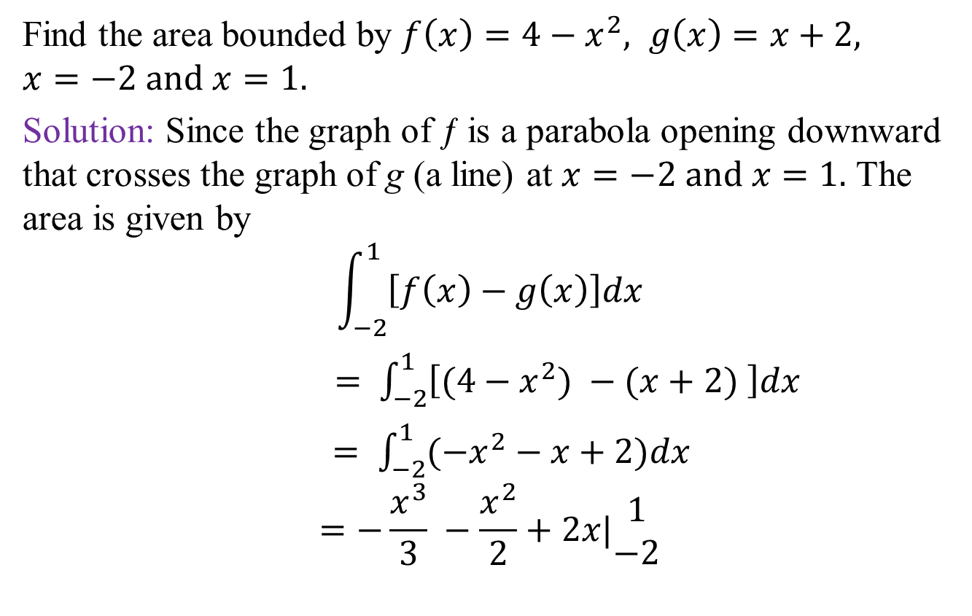
Example: The Area Between Two Curves
(Your Turn 1 in Text)
Find the area bounded by $f\left(x\right)=4−x^{2}, g\left(x\right)=x+2,$
$$x=−2 and x=1.$$
Solution: Since the graph of ƒ is a parabola opening downward that crosses the graph of g (a line) at $x=−2 and x=1.$ The area is given by
$$\int_{−2}^{1}{\left[f\left(x\right)−g\left(x\right)\right]dx}$$
$= \int_{−2}^{1}{\left[(4−x^{2}) −(x+2) \right]dx}$
$= \int_{−2}^{1}{(−x^{2}−x+2)dx}$
$$=−\frac{x^{3}}{3} −\frac{x^{2}}{2}+2x|\begin{matrix}1 \\ −2\end{matrix}$$
Continued

Slide 66
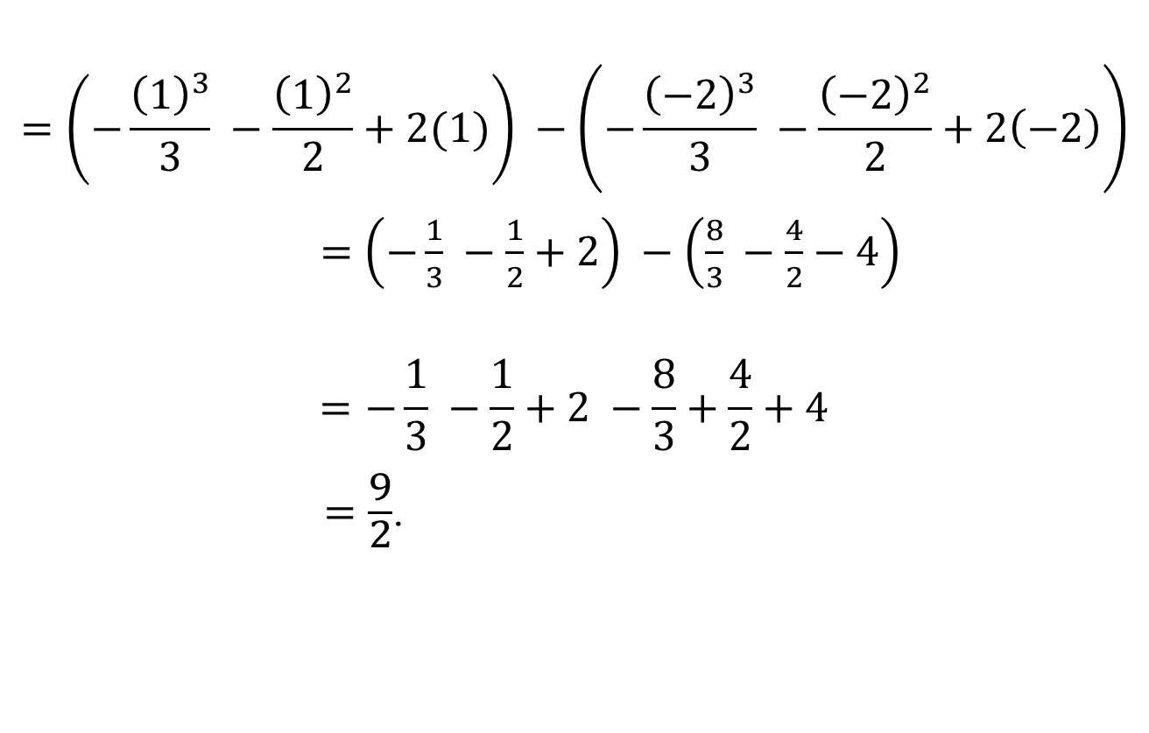
Example: The Area Between Two Curves continued
(Your Turn 1 in Text)

Slide 67
(Figure 23 in Text)
The Area Between Two Curves

Slide 68
(Figure 24(a) in Text)
Area (Using a Graphing Calculator)

Slide 69
(Figure 24(b) in Text)
Definite Integrals (Using a Graphing Calculator)

Slide 70
(Figure 25(a) in Text)
Area

Slide 71
(Figure 25(b) in Text)
Area

Slide 72
(Figure 26 in Text)
Area

Slide 73
(Figure 27 in Text)
Savings

Slide 74
(Figure 28 in Text)
Consumers’ Surplus

Slide 76
(Figure 29 in Text)
Producers’ Surplus

Slide 78
(Figure 30 in Text)
Consumers’ and Producers’ Surplus

Slide 79
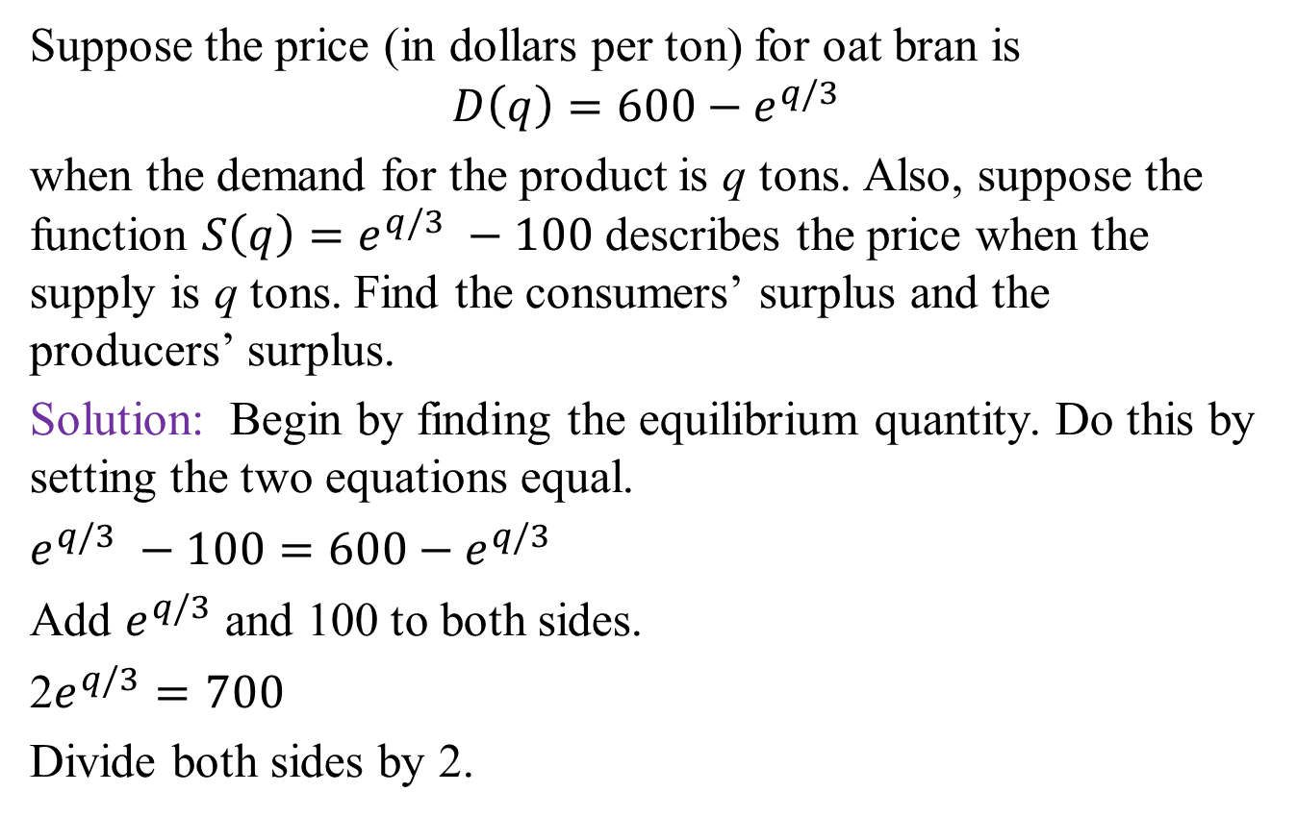
Example: Consumers’ and Producers’ Surplus
(Your Turn 4 in Text)
Suppose the price (in dollars per ton) for oat bran is $$D\left(q\right)=600−e^{q/3}$$
when the demand for the product is q tons. Also, suppose the function $S\left(q\right)=e^{q/3} −100$ describes the price when the supply is q tons. Find the consumers’ surplus and the producers’ surplus.
Solution: Begin by finding the equilibrium quantity. Do this by setting the two equations equal.
$e^{q/3} −100=600−e^{q/3}$
Add $e^{q/3}$ and 100 to both sides.
2$e^{q/3}=700$
Divide both sides by 2.
Continued

Slide 80
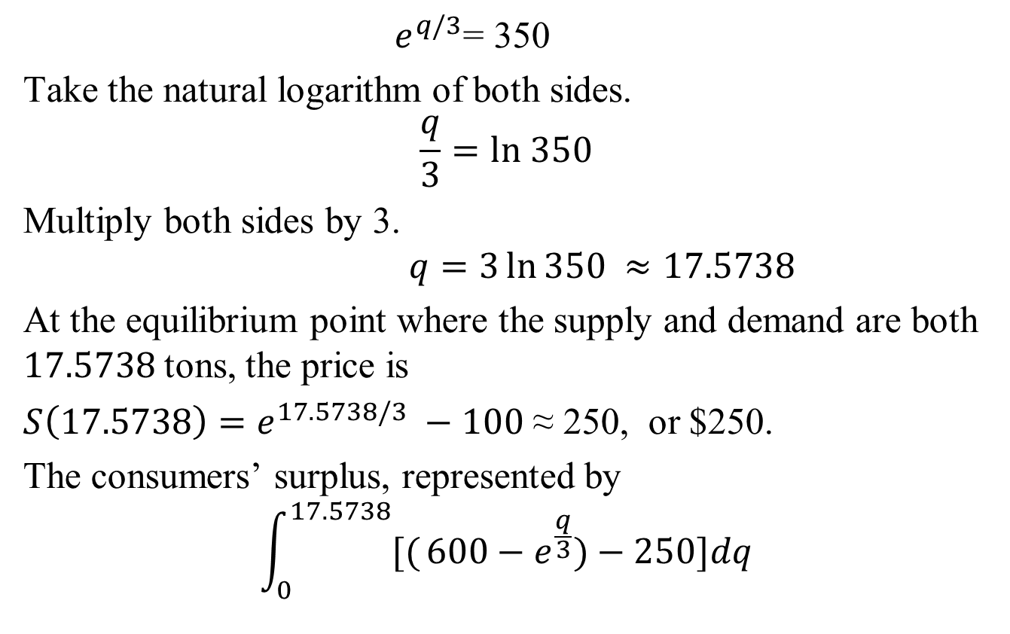
Example: Consumers’ and Producers’ Surplus continued
(Your Turn 4 in Text)
Continued

Slide 81
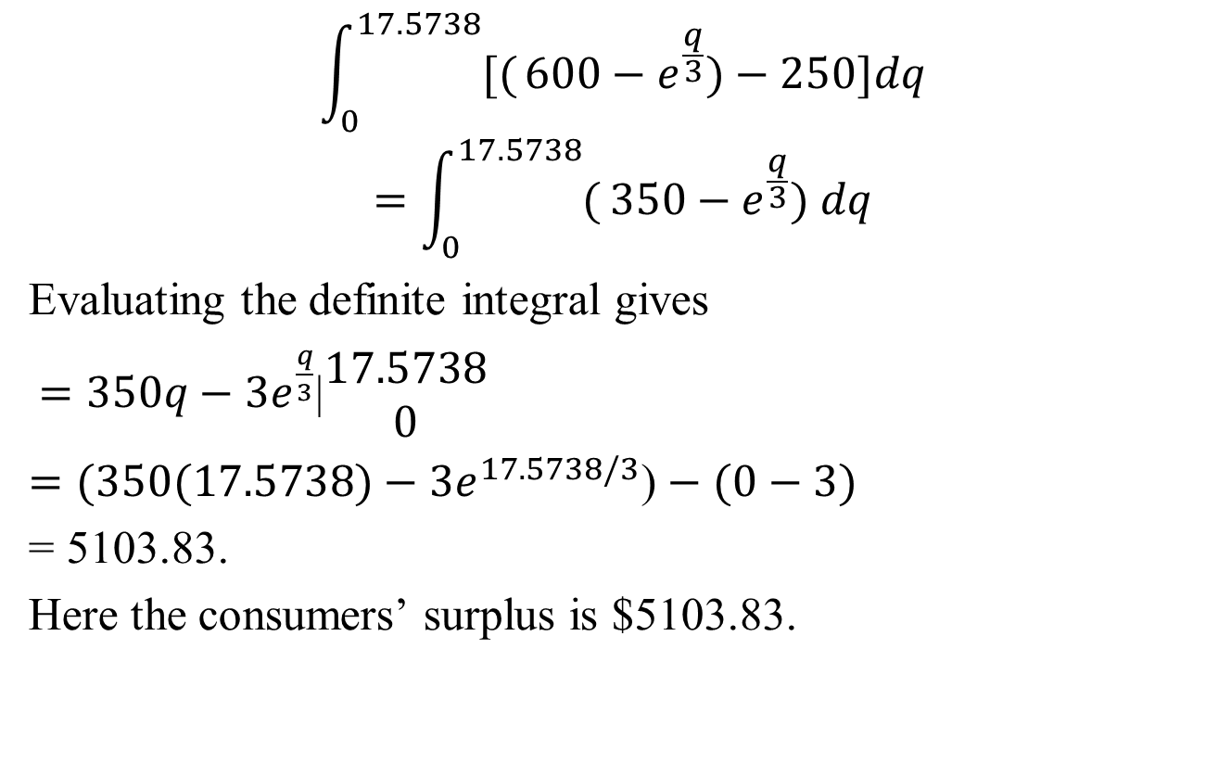
Example: Consumers’ and Producers’ Surplus continued
(Your Turn 4 in Text)
Continued

Slide 82
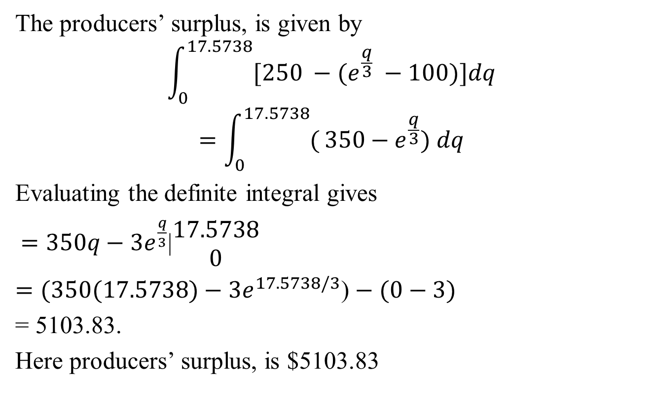
Example: Consumers’ and Producers’ Surplus continued
(Your Turn 4 in Text)

Slide 83
15.6
Numerical Integration

Slide 84
(Figure 31 in Text)
Trapezoidal Rule

Slide 85
(Figure 32 in Text)
Trapezoidal Rule

Slide 88
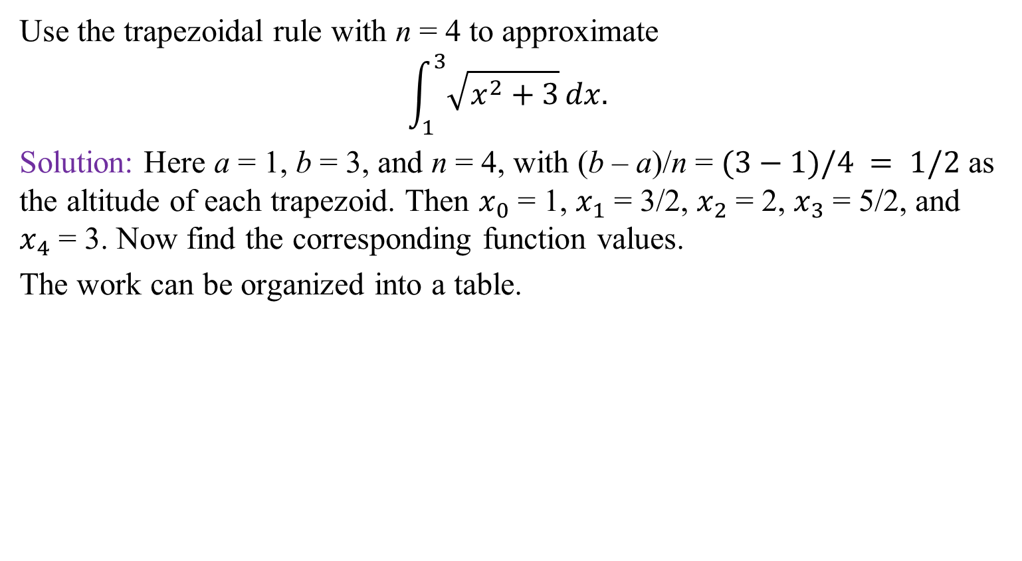
Example: Trapezoidal Rule
(Your Turn 1 in Text)
Use the trapezoidal rule with n = 4 to approximate
$$\int_{1}^{3}{\sqrt{x^{2}+3}}dx.$$
Solution: Here a = 1, b = 3, and n = 4, with (b – a)/n = $(3−1)/4 = 1/2$ as the altitude of each trapezoid. Then $x_{0}$ = 1, $x_{1}$ = 3/2, $x_{2}$ = 2, $x_{3}$ = 5/2, and $x_{4}$ = 3. Now find the corresponding function values.
The work can be organized into a table.
Continued

Slide 89
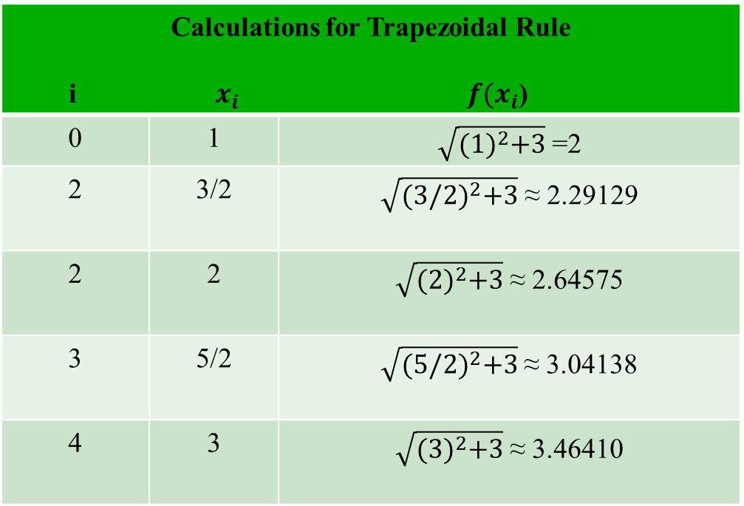
Example: Trapezoidal Rule continued
(Your Turn 1 in Text)
Calculations for Trapezoidal Rule i $x_{i}$ $f(x_{i}$)
0 | 1 | $\sqrt{{(1)}^{2}+3}$=2
2 | 3/2 | $\sqrt{{(3/2)}^{2}+3}$ ≈ 2.29129
2 | 2 | $\sqrt{{(2)}^{2}+3}$≈ 2.64575
3 | 5/2 | $\sqrt{{(5/2)}^{2}+3}$≈ 3.04138
4 | 3 | $\sqrt{{(3)}^{2}+3}$≈ 3.46410
Continued

Slide 90
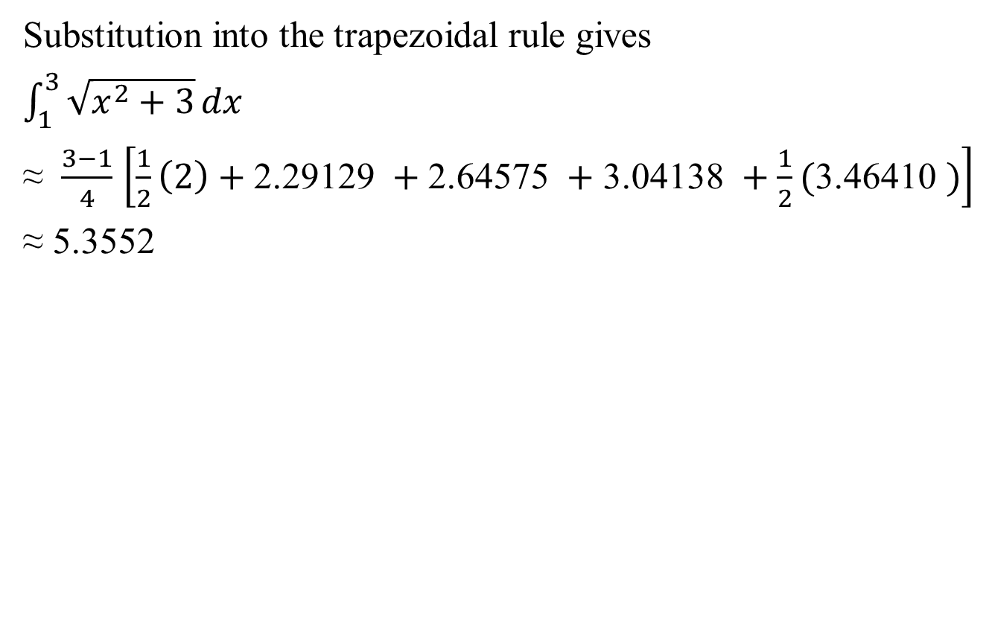
Example: Trapezoidal Rule continued
(Your Turn 1 in Text)

Slide 91
(Figure 33 in Text)
Simpson’s Rule

Slide 94

Example: Simpson’s Rule
(Your Turn 2 in Text)
Use the Simpson’s rule with n = 4 to approximate
$$\int_{1}^{3}{\sqrt{x^{2}+3}}dx.$$
Solution: a = 0, b = 2, and n = 4, and the endpoints of the four
intervals are $x_{0}$ = 1, $x_{1}$ = 3/2, $x_{2}$ = 2, $x_{3}$ = 5/2, and $x_{4}$ = 3.
The table of values is also the same.
Continued

Slide 95
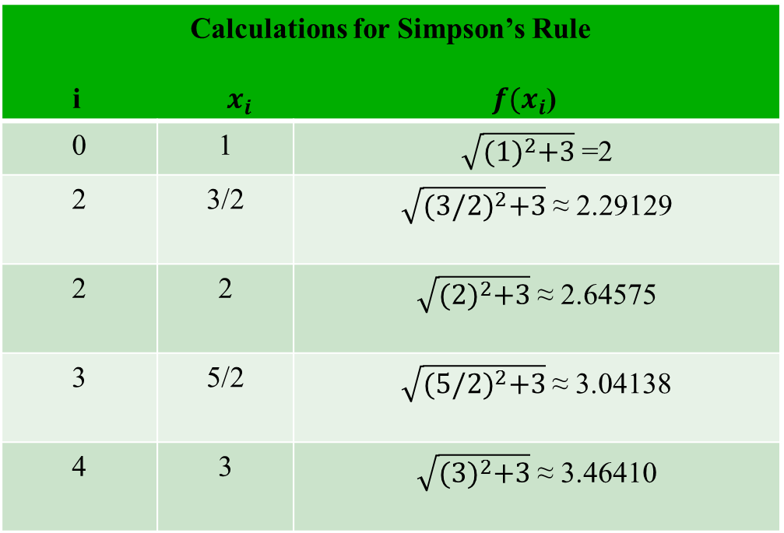
Example: Simpson’s Rule continued
(Your Turn 2 in Text)
Calculations for Simpson’s Rule i $x_{i}$ $f(x_{i}$)
0 | 1 | $\sqrt{{(1)}^{2}+3}$=2
2 | 3/2 | $\sqrt{{(3/2)}^{2}+3}$ ≈ 2.29129
2 | 2 | $\sqrt{{(2)}^{2}+3}$≈ 2.64575
3 | 5/2 | $\sqrt{{(5/2)}^{2}+3}$≈ 3.04138
4 | 3 | $\sqrt{{(3)}^{2}+3}$≈ 3.46410
Continued

Slide 96
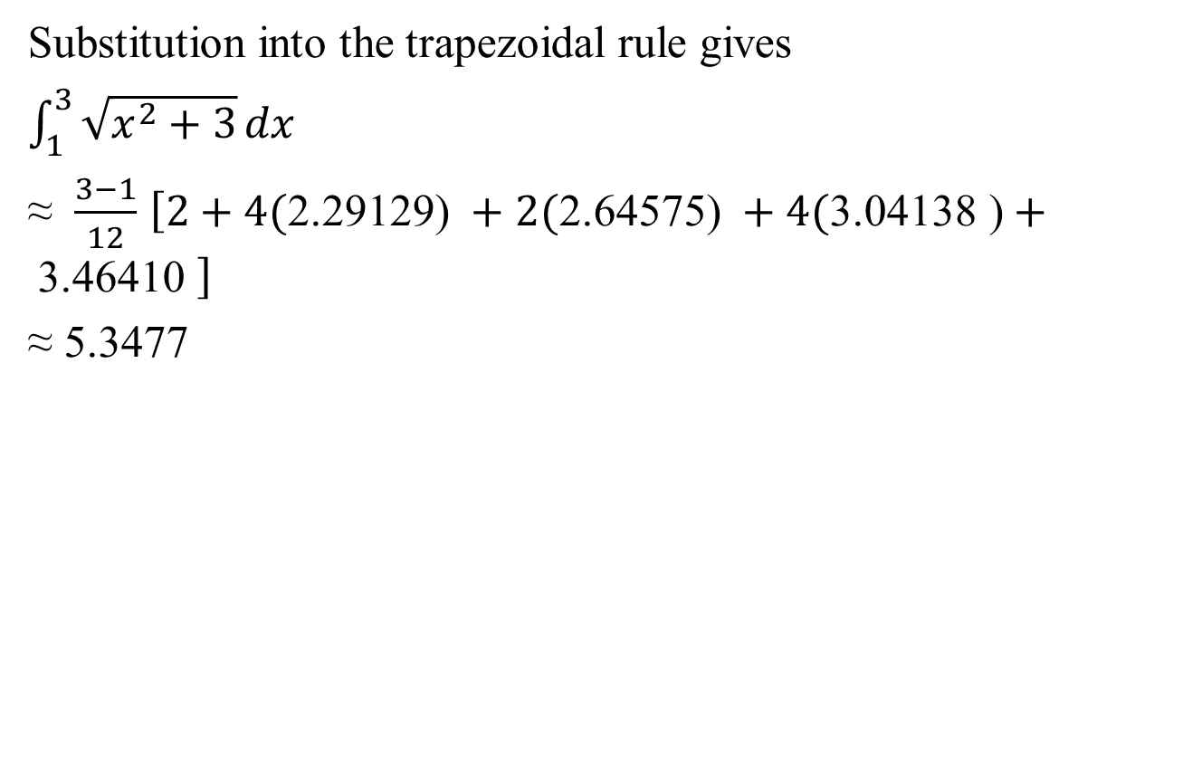
Example: Simpson’s Rule continued
(Your Turn 2 in Text)

Slide 98
Chapter 15 Review
Extended Application: Estimating
Depletion Dates for Minerals

Slide 99
(Figure 34 in Text)

Slide 101
(Figure 35 in Text)

